Slide 1

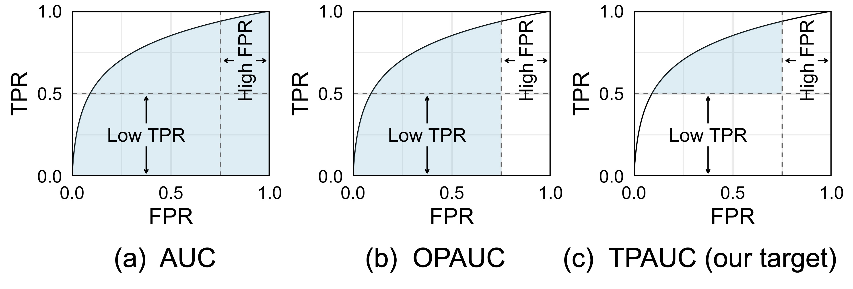

When All We Need is a Piece of the Pie: A Generic Framework for Optimizing Two-way Partial AUC
Presented by: Zitai Wang
2021.7.19

Slide 2
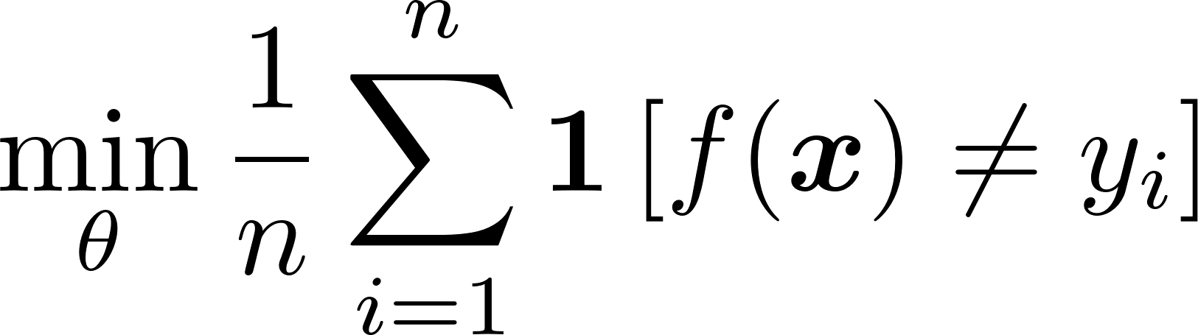
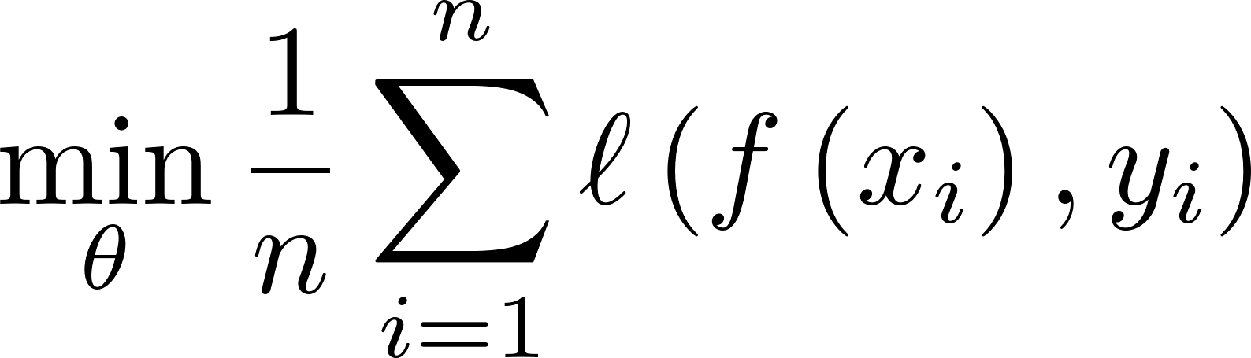

Background
Cat
Not Cat
Sample
Model
Prediction
Traditional classification methods adopt error-rate-guided ERM.
sensitive to class distribution
surrogate
Notes:
To learn a classification model, traditional methods often minimize the empirical estimation of the error rate on a training dataset.
[Press x 2]
The simple form of the risk function brings great convenience and scalability to optimizations. However, each of the term has an equal weight as 1 over the total number of instances, making it sensitive toward class distribution.
This is OK with an assumption that class distribution is balanced

Slide 3
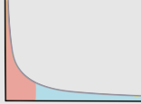
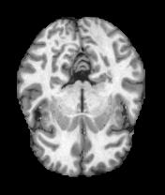
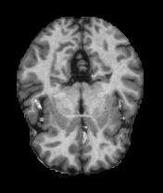
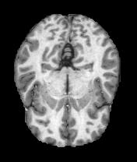

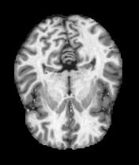
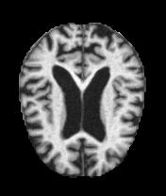
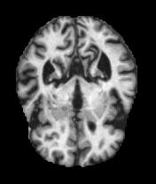
Background
Such ERM paradigm is problematic for imbalanced/long-tailed
datasets
Long-tailed data
Spam Detection
Disease Diagnosis
Sample
Head-class
Tail-class
It is easy to get a high accuracy score by simply predicting all the samples as the majority class!
Notes:
However, many real-world applications such spam detection and disease diagnosis are naturally imbalanced.
For those datasets, the class distribution is highly skewed such that the vast majority of the samples are coming from the head classes or the majority classes.
In such cases, you might observe a very high acc, but only to find that all the samples are predicted the majority class or head class, which is complete meaningless. So how to fix it for long-tail data?

Slide 4
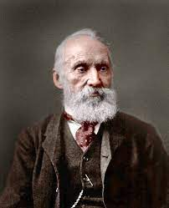
Background
If you can not measure it,
you can not improve it
~Lord Kelvin
Seek out a suitable metric for imbalanced datasets
Notes:
The famous physicist William Thomson once said that If you can not measure it, you can not improve it. So we need to Seek out a suitable metric for imbalanced datasets

Slide 5
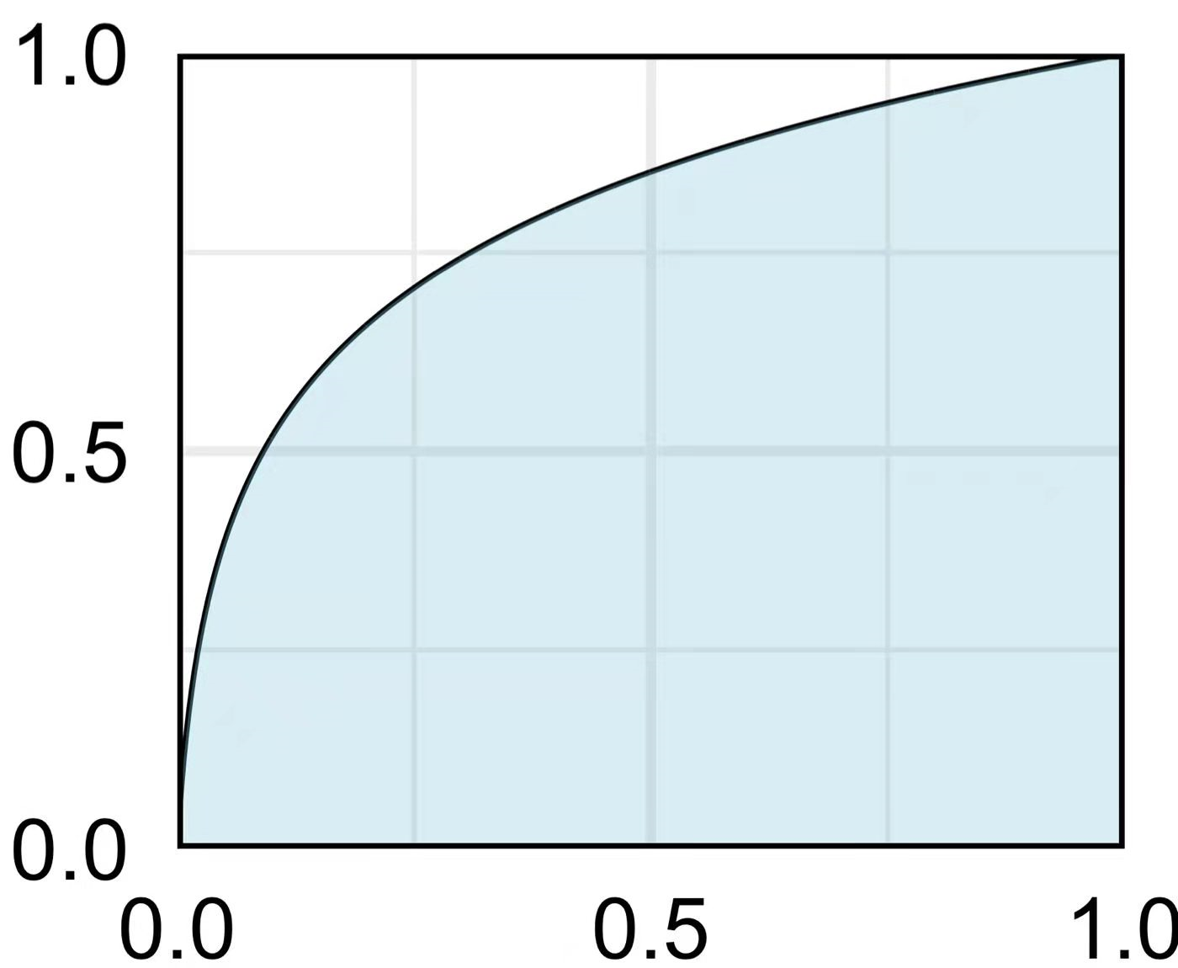
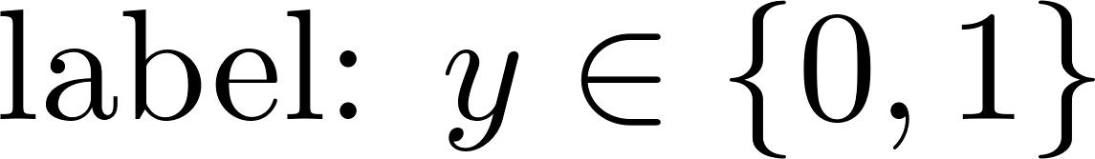
Receiver Operating Characteristic Curve (ROC)
ROC curve: True Positive Rate (TPR) vs. False Positive Rate (FPR).
Decision with a fixed threshold
TPR
FPR
Notes:
In this paper, we are especially interested in what called the Receiver Operating Characteristic Curve and the calculation of its area.
ROC is a curve showing the performance of a given classifier at all possible classification thresholds.
Given binary classification problem, one we can learn scoring function f(x) and a classification threshold t. An instance will be predicted as positive if f(x) is greater than the threshold, and negative otherwise. Under this setting, focus on a specific point on the ROC curve, it shows the performance with a fixed threshold t, the x-axis represents the False positive rate which is the possibility to predict a negative instance as positive and the y-axis represents the True Positive Rate which is the possibility to predict a truly positive instance as positive.

Slide 6
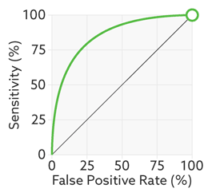
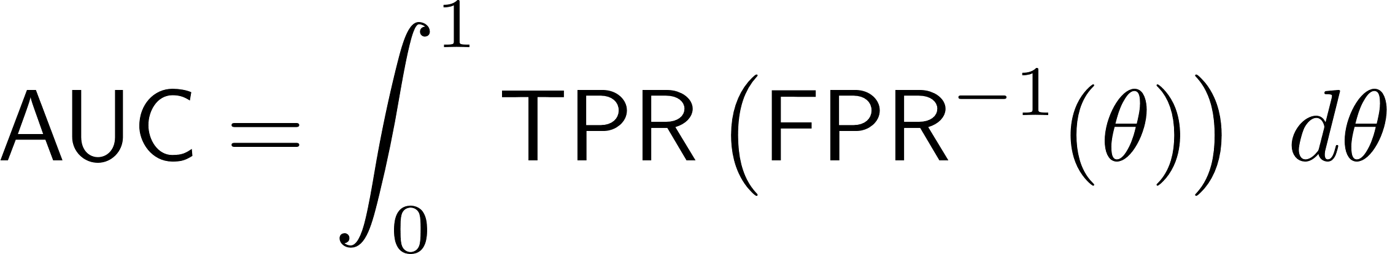
Area Under the ROC Curve (AUC)
AUC is the area under the ROC curve (over all possible thresholds)
Involves a non-trivial integral
Notes:
ROC in itself presents a series of performances from a classifier. However, when making decision, we often want a single evaluation metric to aggregate such performances. Practically, we often use the Area Under the ROC curve (AUC) as the aggregated performance.
As its name implies, AUC is the integral of the ROC curve over all possible thresholds. However, the integration is over the classification threshold, making it non-trivial to find an empirical estimation.

Slide 7
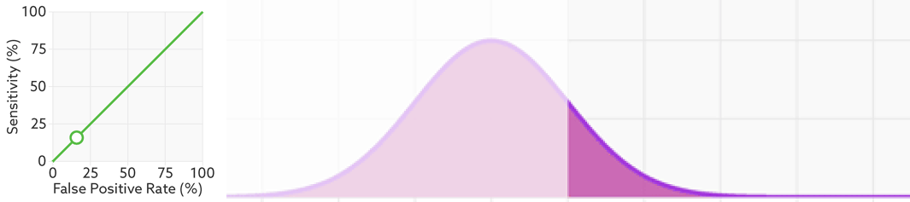
Area Under the ROC Curve (AUC)
A much simpler reformulation:
A measure of how well the two class conditional p.d.fs are separated
J. A. Hanley and B. J. McNeil. The meaning and use of the area under a receiver operating characteristic (roc) curve. Radiology, 143(1):29–36, 1982.
Notes:
Nowadays, when measuring AUC, we often employ a reformulation as the probability that the positive instance has a higher score than a negative, where the effect of the thresholds can be canceled.
Moreover, it also suggests that AUC only measures how well the positive scores and separated from the negative ones in distribution, which is irrelevant of the class distribution.

Slide 8
AUC is too informative
Global integration
TPR
Considers all possible TPR and FPR
Real-world problems have performance constraints (e.g., TPR>0.5, FPR < 0.1)
FPR
Consider Local analog of AUC
Notes:
Despite the popularity of AUC, it is also known to have some limitations.
Here in this paper, we are focusing on the problem that AUC is somewhat too informative to meet specific decision requirement.
When calculating AUC, we take a global integration over all possible TPR and FPR.
Obviously, in real-world problems only the classifier whose performance is located at a given range is of interested. This requires the metric employed to focus on specific performance constraints.
In this sense, we should Consider Local analogs of AUC

Slide 9
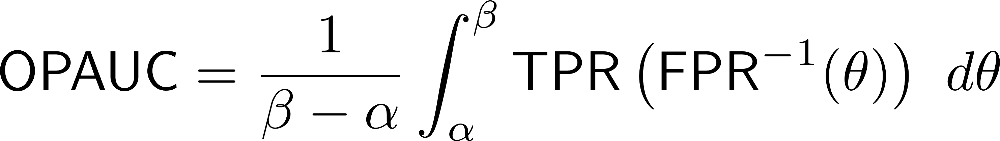
One Way Partial AUC (OPAUC)
AUC involves all possible TPRs and FPRs
Many real-world applications have specific requirement on FPR
Solution: Measure the partial area of ROC
AUC
One way Partial AUC (OPAUC) [Dobb and Pepe 2003]
Notes:
For many real world applications like medical and bioinformatics , there is often a specific requirement on the range of FPR.
Dobb and Pepe in 2003 Proposed a local version of AUC called Partial AUC. Here we call it one way partial AUC to distinguish it from the two way partial AUC metric. One way partial AUC only calculates the Area under ROC within a predefined FPR range alpha beta. So the only difference is here the upper and lower limit in the integral.

Slide 10
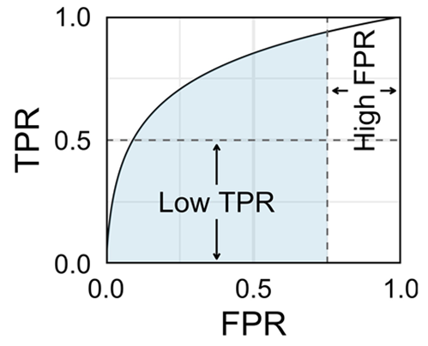
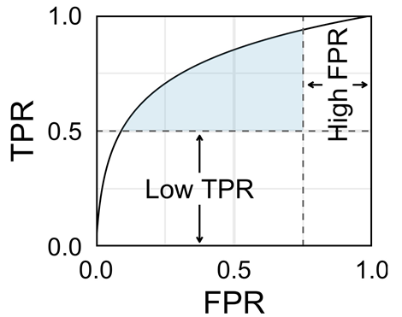

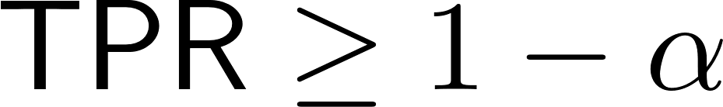
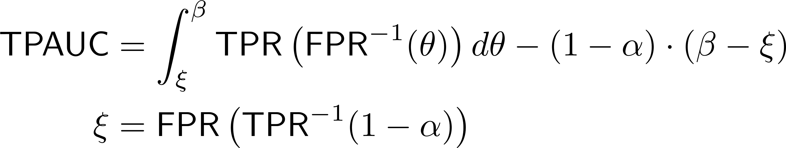
Two Way Partial AUC (TPAUC)
A reasonable case should simultaneously enjoy a low FPR and a high TPR
TPAUC measures the AUC within such a local area
OPAUC
Two way Partial AUC (TPAUC)
[Yang et.al. 2019]
Notes:
Yang etal later argues that a reasonable model should simultaneously enjoy a low FPR and a high TPR. SO they propose a novel metric called Two way partial AUC or TPAUC in short, very recently.
TPAUC only considers the area with FPR less than beta and TPR greater that 1- \alpha. Here not only should we change the upper and lower limit, but we also need to subtract the area of lower rectangle from the integral.

Slide 11
How to optimize local AUCs
OPAUC
Cutting Plane Solvers [Narasimhan et.al. 2013; Narasimhan et.al. 2017; Tomoharu et.al. 2020]
Projected Sub-gradient Descent [Narasimhan et.al. 2013; Narasimhan et.al. 2017; Yamaguchi et.al. 2020]
Evolutionary Algorithms [Fan et.al. 2019]
Sampling Algorithms [Bai et.al. 2020a, b]
TPAUC
?
Not support the end-to-end training!
Requires a sampling process
Do not have theoretical guarantee
Optimize TPAUC
in an end-to-end fashion
Notes:
How to optimize such local AUC metrics?
Well, existing OPAUC optimization includes.
But existing methods either do not support end-to-end training like we do for deep learning or do not have convergence guarantees.
And to the best of our knowledge, the tpauc optimization problem has not yet been studied
So in this paper, our goal is to directly optimize TPAUC directly, moreover we will also do it in an end-to-end fashion.
Partial AUC Estimation and Regression. Lori-Margaret 2003
A Structural SVM Based Approach for Optimizing Partial AUC. [Narasimhan-Agarwal 2013]
Semi-Supervised Learning for Maximizing the Partial AUC, AAA2020
Multi-objective evolutionary algorithm for optimizing the partial area under the ROC. [Fan-Fu-Zhang-Qiu 2019]
Speaker Verification by Partial AUC Optimization With Mahalanobis Distance Metric Learning. [Bai-Zhang-Chen 2020a]
PARTIAL AUC OPTIMIZATION BASED DEEP SPEAKER EMBEDDINGS WITH CLASS-CENTER LEARNING FOR TEXT-INDEPENDENT SPEAKER VERIFICATION. [Bai-Zhang-Chen 2020b]
LTSpAUC: Learning Time-series Shapelets for Optimizing Partial AUC.[Yamaguchi-Maya-Maruchi-Ueno 2020]
TPAUC:
Two-Way Partial AUC and Its Properties. Yang et.al. 2019

Slide 12
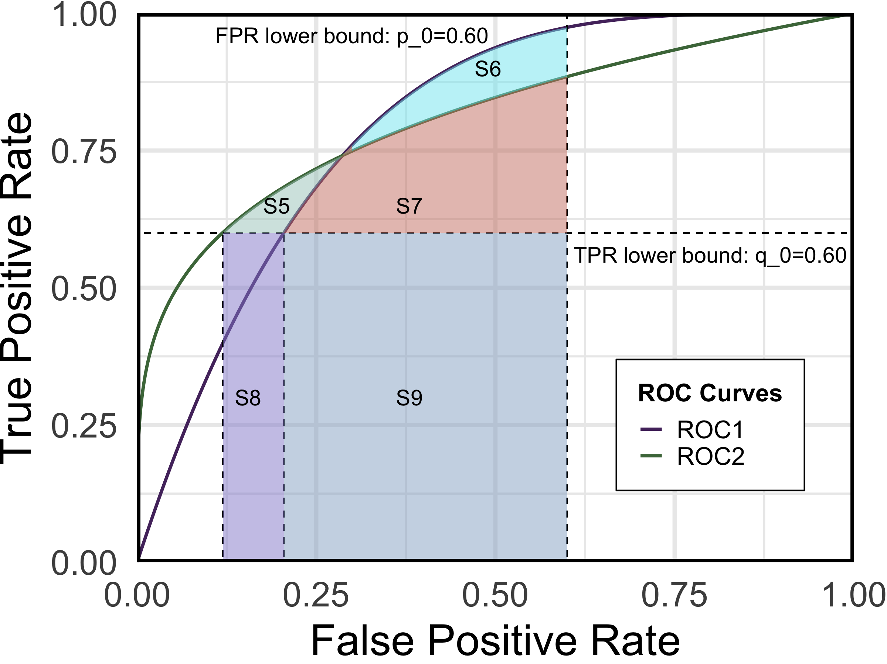
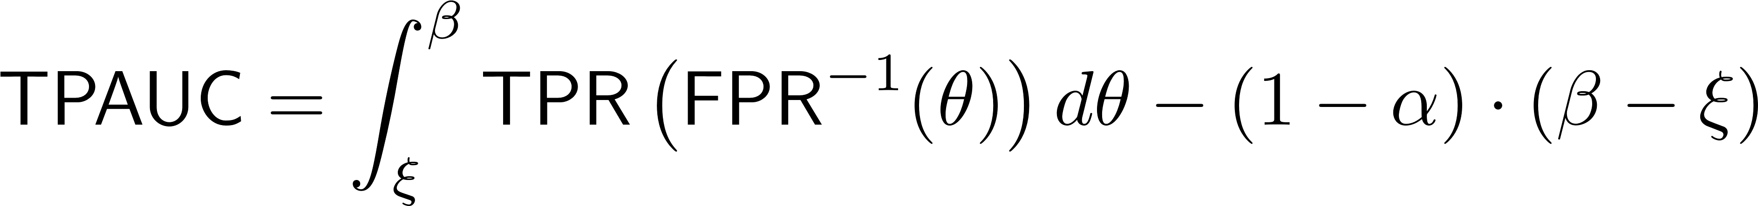
Can We estimate TPAUC from OPAUC ?
Direct optimization is necessary !
TPAUC1 > TPAUC2: S5+S7< S6+S7
OPAUC2 > OPAUC1: S5+S7+S8+S9 > S7+S9+S6
Notes:
Since OPAUC optimization has already been studied. One might wonder that if we can estimation TPAUC directly from OPAUC.
Comparing the definition of OPAUC and TPAUC we see that the answer will be yes if we can approximate \xi with a fixed \beta.
However, this is impossible in general, since $\xi$ is a function of the scoring function f.
Practically, we can also observe that OPAUC and TPAUC tends to provide different comparison result when two ROC intersects.

Slide 13
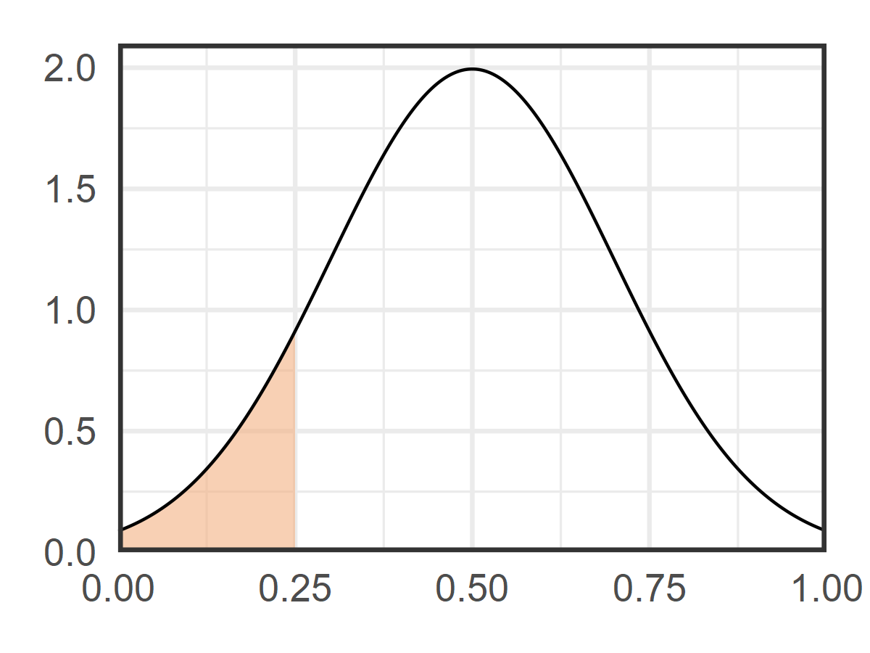
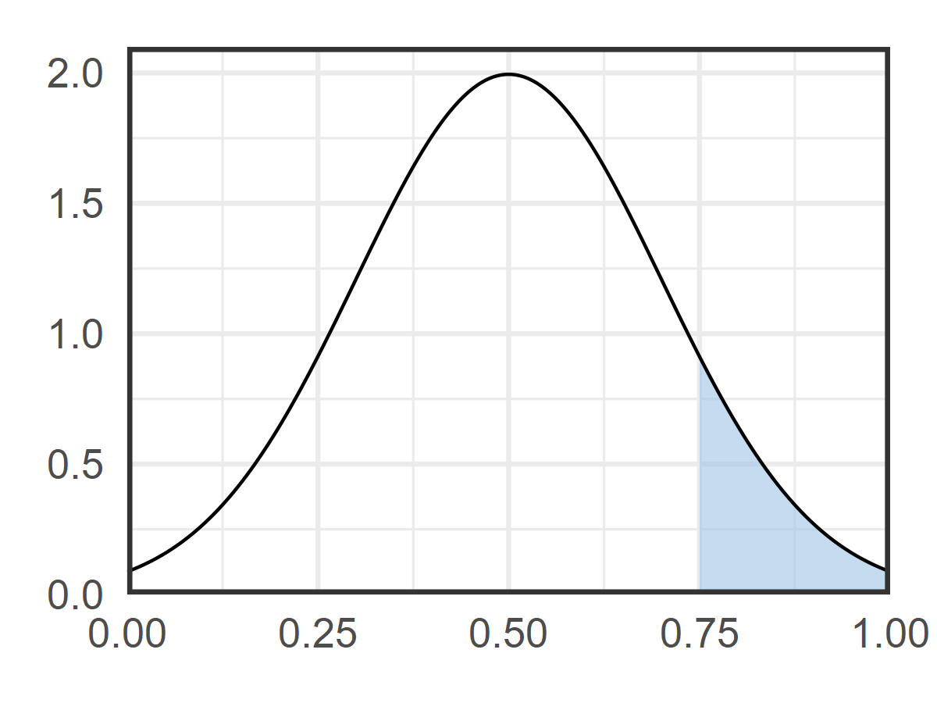


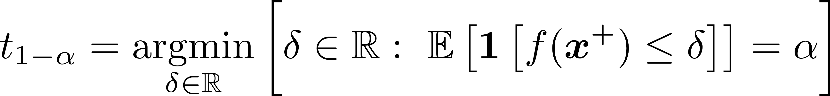
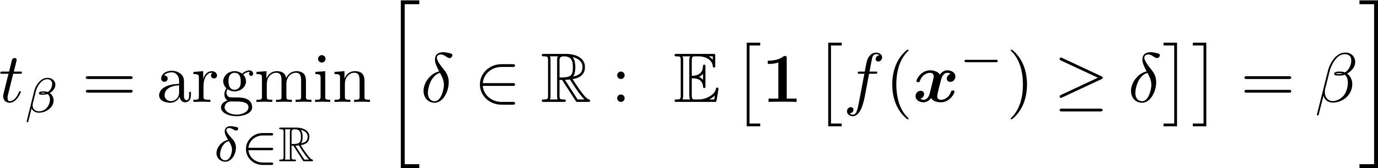
Reformulation of TPAUC
score quantile of the positive class
score quantile of the negative class
Requires empirical estimation of the expectation
Requires empirical estimation of the quantiles
Notes:
To optimize TPAUC on the training data. We also need to reformulate the TPAUC to cancel the thresholds.
Similar to AUC, TPAUC also has reformulation form where the threshold could be canceled.
Especially, it could be also reformulated as the rank accuracy. But here the accuracy is in a truncated form. We only consider the bottom positive instances and top negative instances. And this is controlled by two quantiles respectively for positive and negative class.
Finding an empirical estimation of TPAUC is very difficult. Because we need find an estimation for both the expectation and the quantiles.

Slide 14
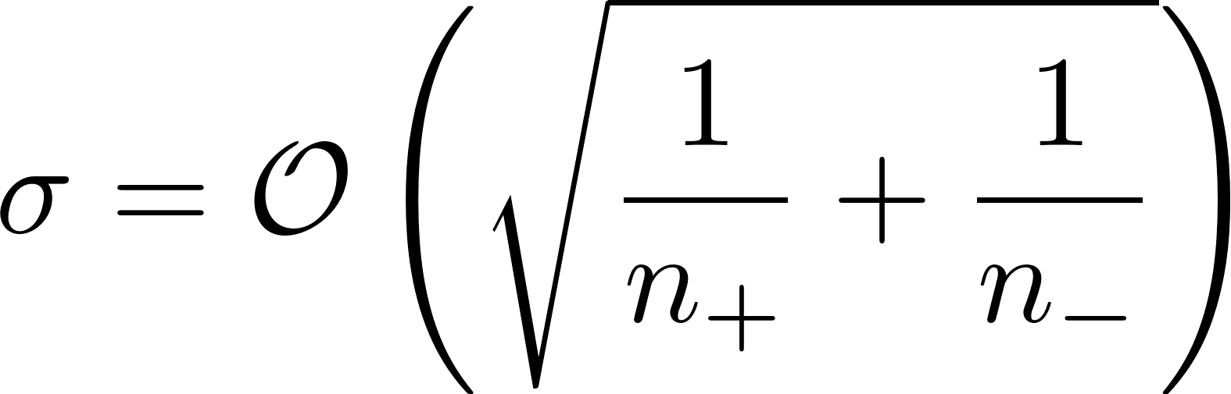
Empirical Estimation of TPAUC
empirical
expectation
empirical
quantile
Theorem 1 Asymptotic Normality of the Bias (Informal) [Yang-Lu-Lyu-Hu 2019]
Notes:
Yang etal in their paper define a simple estimation in the following form, where the expectations and the quantiles are directly replaced with their empirical version.
Unfortunately, this is a biased estimation.
Nonetheless they later show that actually the bias will asymptotically convergences in distribution to a Guassian with zero mean and a vanishing sigma. This somehow gives a theoretical guarantee to be that such a straightforward estimation is good when the sample size is large enough.

Slide 15
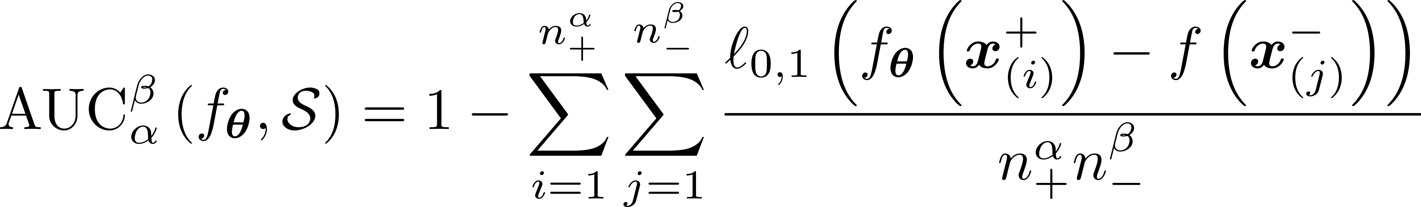
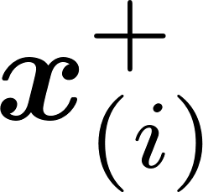
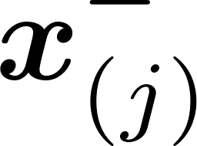

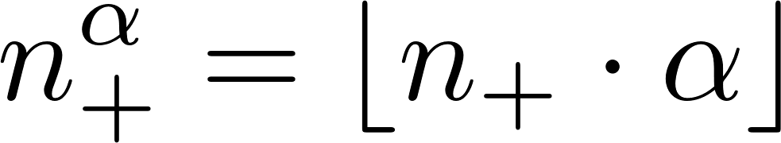
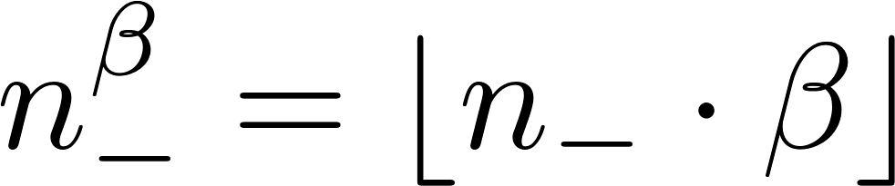

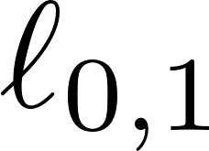

Empirical Estimation of TPAUC
-
+
-
+
-
-
…
+
-
-
+
-
+
+
Optimize Empirical TPAUC approximately
achieves bottom- score among all positive instances.
achieves top- score among all negative instances.
loss is non-differentiable, NP-hard problem
Empirical quantiles are still not decomposable
Notes:
More explicitly, we can rewrite the empirical estimation of TPAUC as 1 minus the truncated ranking loss.
Here x^+_(i) is the i-th samallest positive score and x^+_(j) is the j-th largest negative score. n_+\alpha is the number of the bottom positive instances that we need to consider and n_-\beta is the number of top negative instances we need to consider. Then the ranking loss counts the fraction that the bottom positive instances and top negative instances are mis-ranked.
Next we will present our method to optimize the empirical estimation of TPAUC approximately

Slide 16


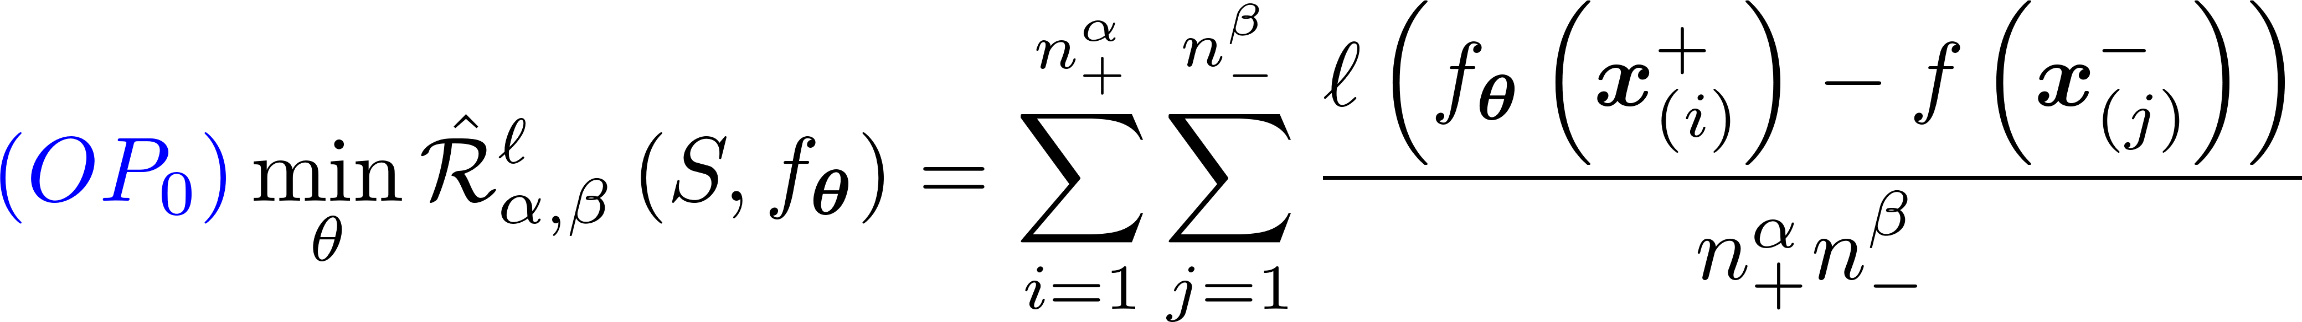
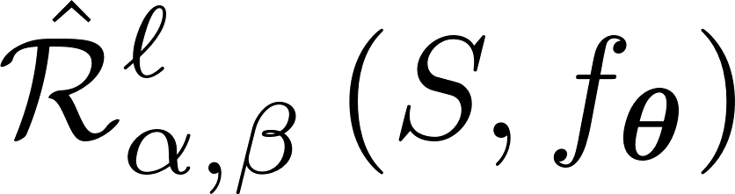
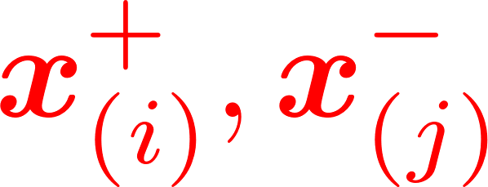
Step1 Surrogate Loss Minimization
Replace with a continuous surrogate
is still not differentiable!
Calculating requires sorting the scores of positive and negative instances.
Notes:
The first step is nontrivial just to replace the 0-1 loss with a continuous surrogate \ell. However, this alone could not fix our problem since the loss function here is still not differentiable, since one still has to sort the whole list of the score to calculate truncated loss.

Slide 17
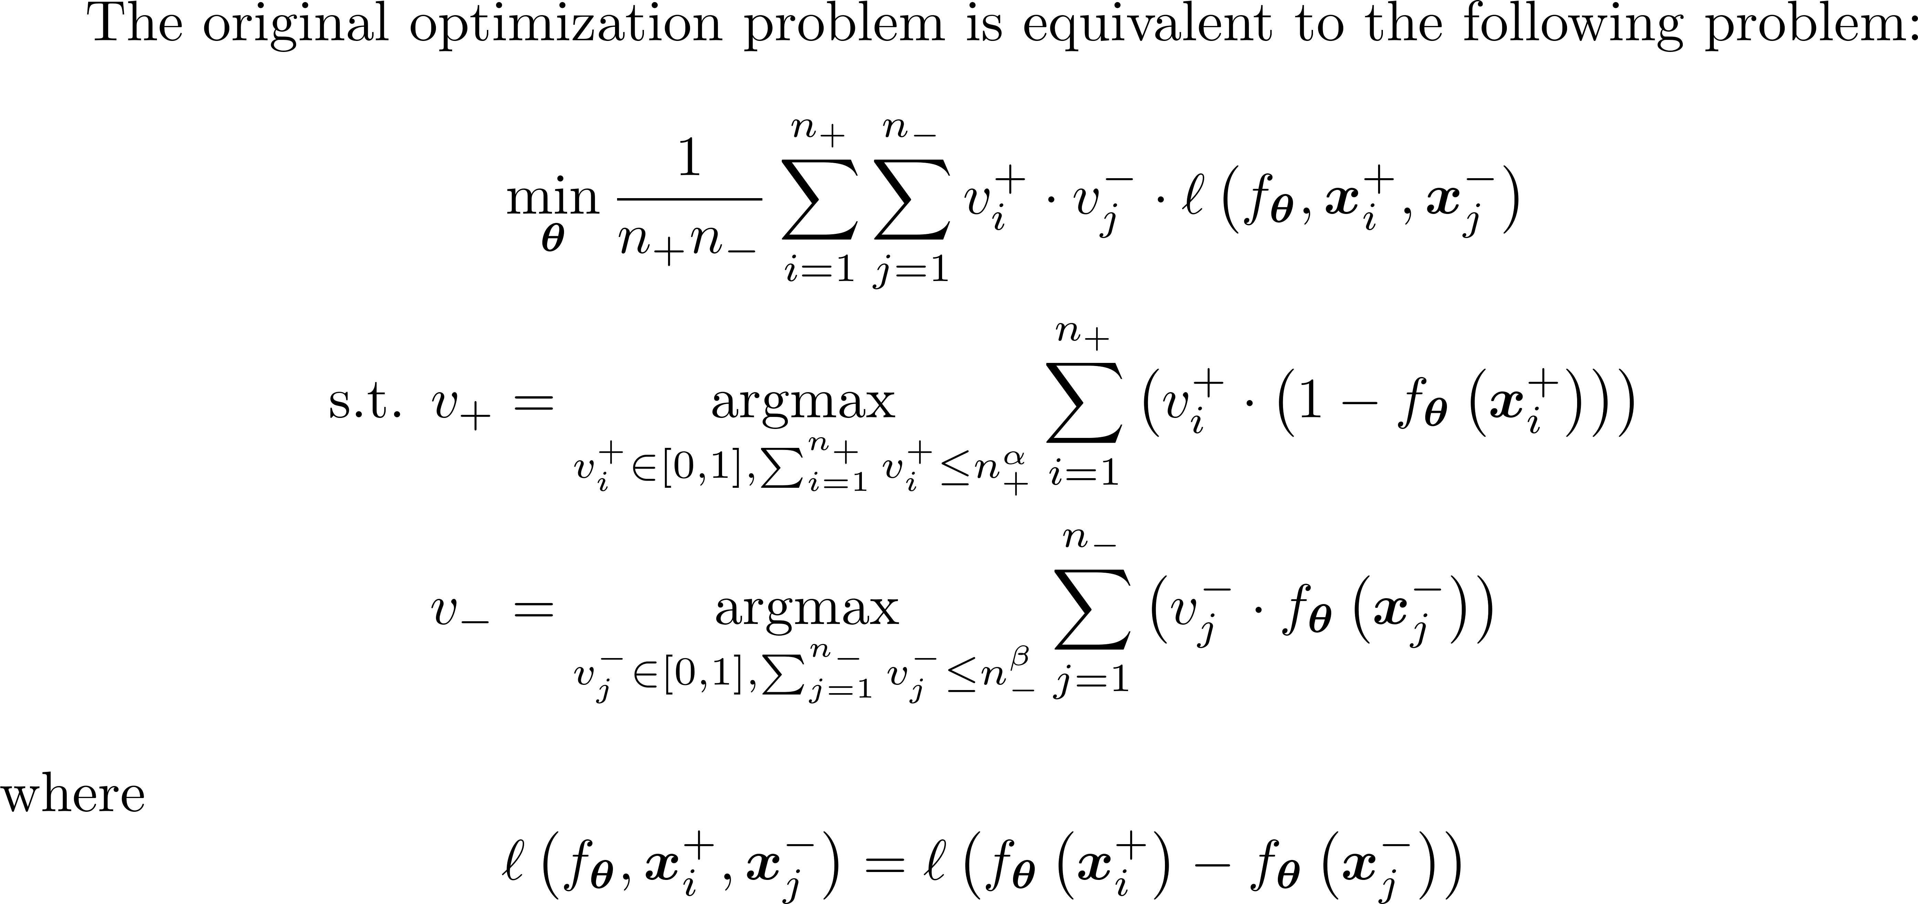
Step2 Bi-level optimization
Outer-level problem optimization based on the chosen instances
The ball constraints makes the optimization intractable
Inner-level problem
a sparse sample selection process
Notes:
The eliminate the effect of the sorting operation, we provide a bi-level reformulation of the original problem. In the new optimization problem, the inner-problem provide the sample selection process to choose the hard instance by generating sparse solutions of v_+ and v_-.
The outer-level problem then optimize the empirical based on instance weights v.
In this reformulated form, the \ell_1 norm ball constraint makes the entire optimization problem nondecomposible toward instances, which is key obstacle toward the end-to-end framework.

Slide 18
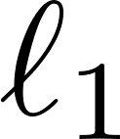
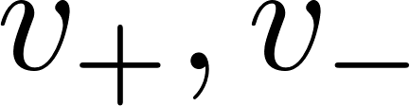
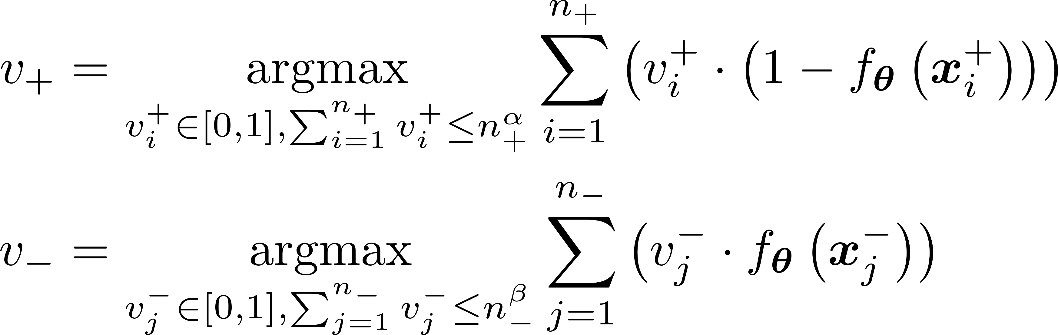
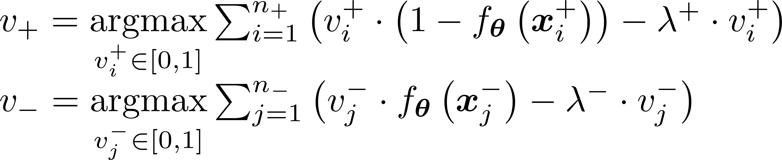
Step2 Bi-level optimization
Transform the ball constraints to penalty terms (note that are non-negative):
Notes:
To fix this, we first reformulated l_1 ball constraint as a l_1 norm regularization in the inner problem. However, this new problem still has a sparse solution.

Slide 19
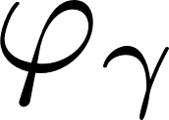
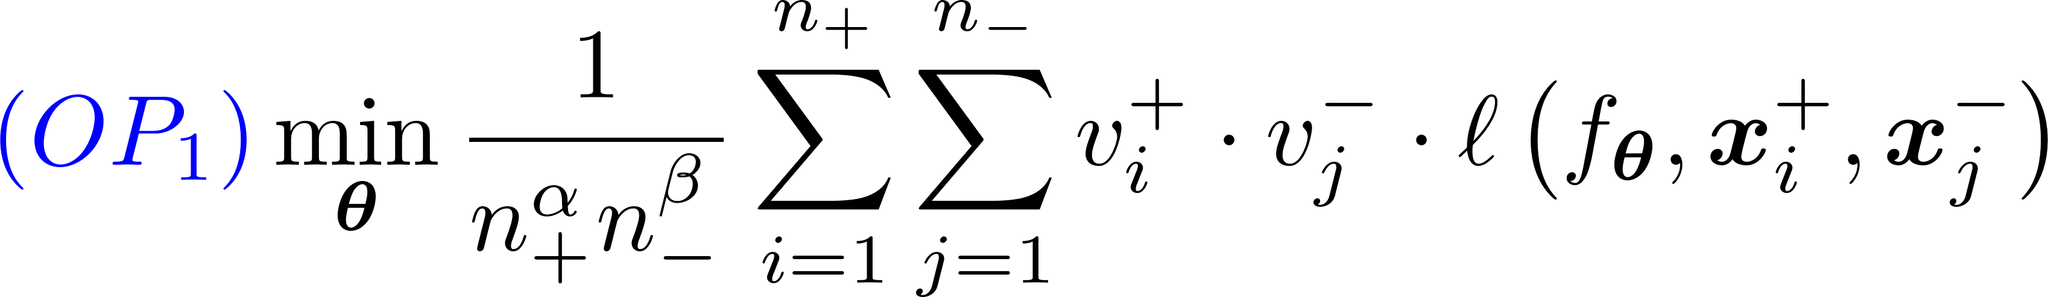
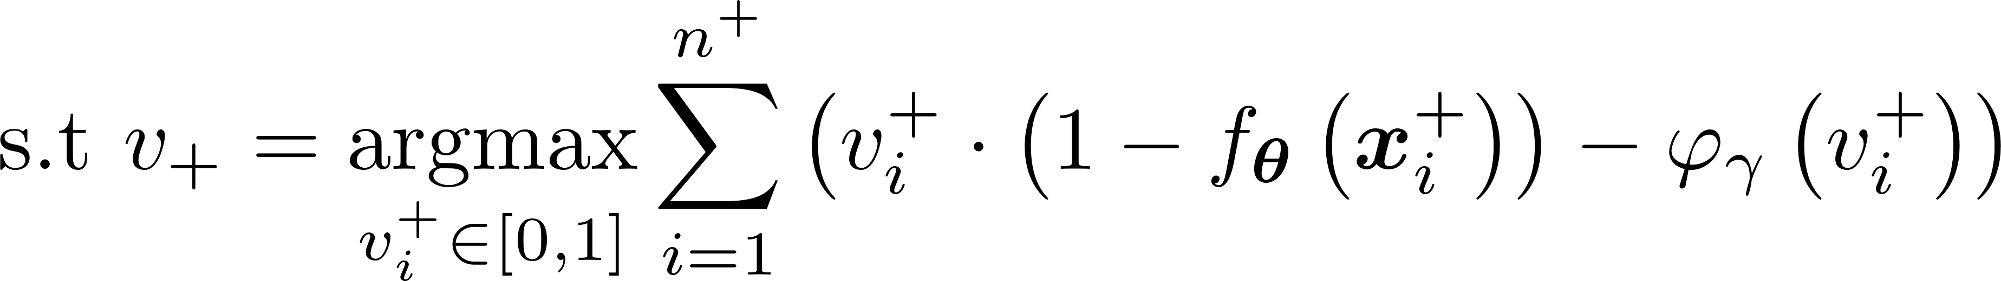
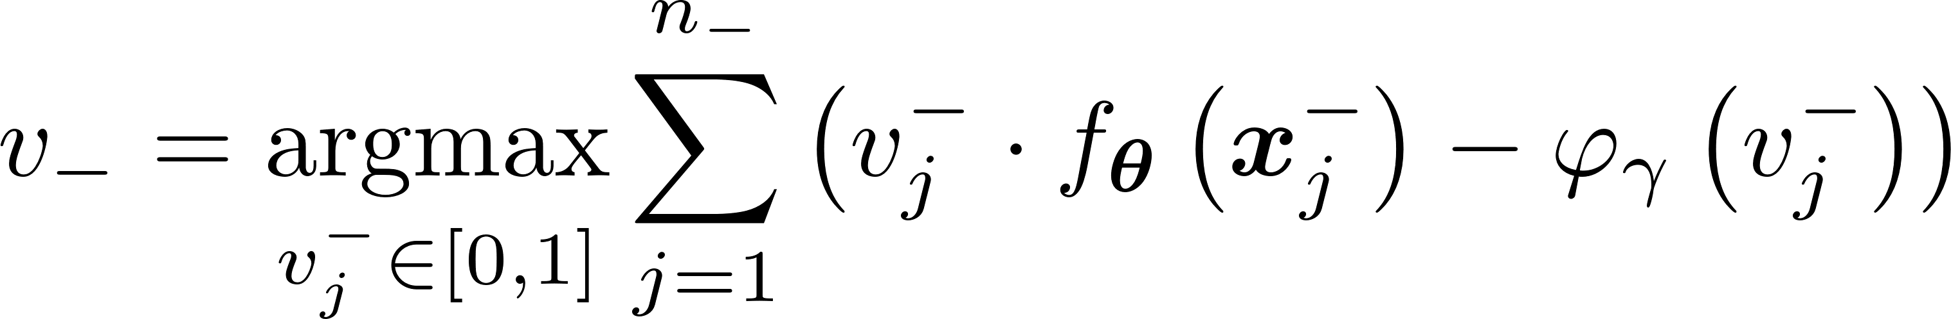
Step2 Bi-level optimization
Replace the sparsity-inducing penalty with a smooth surrogate
Sample Weights
Choose what to
learn in the outer level problem
Penalty Function
Choose the weighting strategy
The connection between weight and the penalty is the key
Notes:
To avoid sparsity, we replace the l_1 regularizer with a smoothed penalty \phi_\gamma.
This leads to our generic framework OP1. Now the sample selection process becomes a tunable weighting process. In this framework, we have two interesting components.
The first component are the sample weights v_+ and v_ which decide what to learn in the outer level problem.
The second component is the penalty which decides the weighting strategy.
In the next few slides, we will make it clear that the connection between the sample weights and the penalty function is the key to an end-to-end framework.

Slide 20
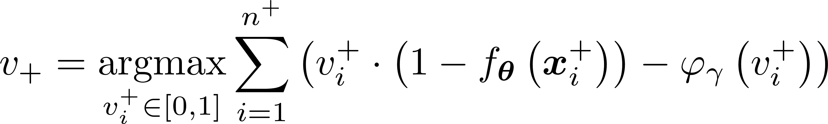
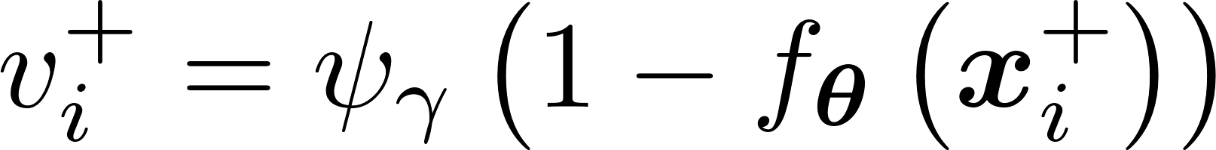
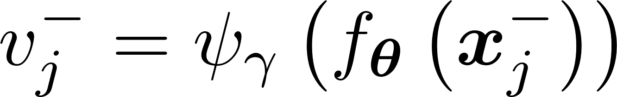
Step3 Dual Correspondence
With a Closed-form Solution
weighting function
Under what condition can we realize such a simplification ?
Notes:
For OP1, we see that OP1 could be simplified as a one-level if we can seek out a closed-form solution of the inner problems. In this case, both v_+, v_- could be formulated as a function of the instance score. We denote this function as \psi_\gamma and refer to it as the “weighting function”.
So under what condition can we realize such a closed form soltuion.
Well it turns out that we need to push some regularities on both the weighting function \psi and the penalty function \phi.

Slide 21
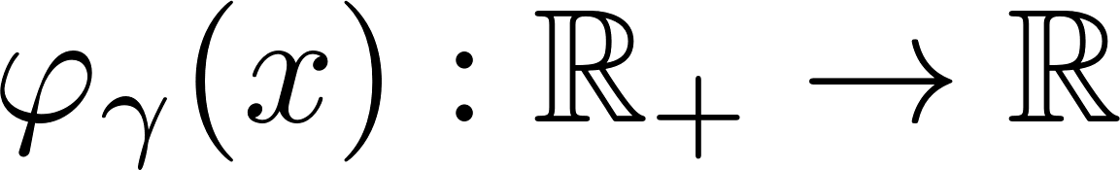








Step 3 Dual Correspondence
Definition 1 Calibrated Smooth Penalty Function
A penalty function satisfies the following regularities:
(A) has continuous third-order derivatives.
(B) is strictly increasing in the sense that
(C) is strictly convex in the sense that
(D) has positive third-order derivatives in the sense that
Definition 2 Calibrated Weighting Function
A weighting function , where , satisfies the following regularities:
(A) has continuous second-order derivatives.
(B) is strictly increasing in the sense that
(C) is strictly concave in the sense that
Notes:
To do this, we introduce the calibrated smooth penalty function. And the calibrated weighting function as .

Slide 22




Step 3 Dual Correspondence
Proposition 1
Given a strictly convex function , and define as
Then we can draw the following conclusions:
(a) If is a calibrated smooth penalty function, we have
(b) If is a calibrated weighting function such that , we have
penalty to weight
weight to penalty
This provides a simple way to establish a surrogate optimization problem of TPAUC
Notes:
With these definition, we come to a dual correspondence theory.
It means that once we have a calibrated smooth penalty function or a weighting function, we can obtain the other immediately by taking either a derivate or a integration.
Now with proposition, we come to have much simpler optimization problem.

Slide 23
Step 3 Dual Correspondence
Given the penalty functions ,
If has a closed-form expression
Cancel the inner optimization problem
Weighted empirical risk:
Notes:
We could cancel the inner optimization problem and instead minimize the following Weighted empirical risk, which is a simple one-level problem and could implemented with the standard end-to-end framework.

Slide 24





Instantiations of the Generic Framework
Example 1 (Polynomial Surrogate Model).
Example 2 (Exponential Surrogate Model).
Notes:
Practically, we provide two instantiations of the generic first. By employing a polynomial penalty function to approximate the ell_1 penalty, we end up with a polynomial surrogate model as the following. By employing a concave exponential weighting function, we end up with an exponential model.

Slide 25





Theoretical Analysis: concave vs. convex weighting function
Proposition 2 (Informal).
Concave functions are always easier to induces an upper bound of the original objective function
A sufficient condition for achieving the upper bound:
surrogate risk
true
risk
S₁/S₂ should be large
The empirical distribution
has significant mass over instances with moderate difficulty
Notes:
Next , we provide theoretical guarantees for our proposed model from two aspects. Firstly, we want to answer question of how to choose a weighting function to make the approximation effective.
Well, as we can see from the figure, the surrogate loss becomes an upper bound of the original 0-1 loss if S1/S2 is large. So concave function should be a better choice intuitively.
Theoretically, we can also prove that concave weighting functions are actually easier to achieve the upper bound.
Moreover, we also provide a sufficient condition to achieve the upper bound. The result suggest that the surrogate risk becomes an upper bound when the empirical distribution has significant mass over instances with moderate difficulty.

Slide 26




Theoretical Analysis: concave vs. convex weighting function
Validation on simulated Dataset
Notes:
To validate whether the sufficient condition could hold. We generate a series of 50 simulated dataset. For each dataset, we have 100 data points from positive and negative class each. The score subjects to a guassian with mean 0.5, variance 0.08, negative scores subjects to a guassian with mean 0.3 and variance 0.08. The sufficient condition requires us to find p and q such that \rho_p > \xi_q.
We plot their log transformation on the figure. We can see clearly that this condition holds for all the 50 trails.

Slide 27



Theoretical Analysis: Excess risk bound
Theorem 2 (Informal).
The following inequality holds with high probability:
The empirical risk is biased
where is the big-O complexity notation hiding the logarithm factors,
and is the VC dimension of the hypothesis class:
Notes:
To validate the generalization ability of model, we can also prove the generalization bound for our ERM framework. It shows that the excess risk is in O\sqrt(VC dim/n_+) + \sqrt{VC dim / n_-} for a given VC class defined as T(F) and for any weighting function \phi achieving an upper bound. Note that prove is not trivial because the empirical loss we used is biased. We have fix this problem by a series of error decomposition.

Slide 28


Empirical Results
We construct long-tail binary datasets with different subsets:
Binary CIFAR-10-LT Dataset
Binary CIFAR-100-LT Dataset
Binary Tiny-ImageNet-200-LT Dataset
We adopt the following variant of the TPAUC metric:
Notes:
In the experiments, we construct long-tail binary datasets from three datasets: CIFAR-10, CIFAR-100 and Tiny-Imagenet. We create three binary subsets for each of them, resulting in 9 dataset subsets.
We adopt the TPAUC as our evaluation metric with alpha =0.3 ,beta =0.3; alpha =0.4, beta = 0.4 and alpha =0.5, beta =0.5.
We use the square loss as the surrogate loss function.

Slide 29




Empirical Results
We consider TPAUC with
Table 1 shows the performance comparison against other methods dealing with imbalanced data.
The empirical results demonstrate the superiority of our proposed TPAUC algorithm.
Notes:
Table 1 shows the performance comparison against other methods dealing with imbalanced data.
The empirical results demonstrate the effectiveness of our proposed TPAUC algorithm.

Slide 30

Validation of the upper bound
We show the training curve of different losses, where we consistently observe that :
This validate the proposed proposition about concave weights.
App. Surr. Loss > Surr. Loss > emp. TPAUC
Notes:
So can approximated loss function achieves the upper bound during the training process?
We validate this property empirical on the first subset on CIFAR-10 with a concave polynomial model. Here in the figure the blue line shows the approximated surrogate loss, the green line shows the empirical surrogate loss, and the red line shows the 0-1 loss.
The results show that the approximated loss is always an upper bound of the surrogate loss and the 0-1 loss.

Slide 31








Convex vs. Concave Weighting
We analyze the effect of on CIFAR-10-Subset-1 with poly model
The results shows that the concave function significantly outperforms convex functions
Notes:
Finally we validate the performance of concave weighting functions vs. the convex weighting functions.
To do this, we analysis the effect of gamma on CIFAR-10-subset-1 with the polynomial model.
The shows that the concave function with 1 over (1 minus \gamma) less than 1 significantly outperforms the

Slide 32

Conclusion
How to optimize TPAUC (AUC with FPR upper bound and a TPR lower bound) in an end-to-end manner?
Problem
A Bi-level reformulation of ERM framework for TPAUC
A relaxation scheme for sample selection of the inner-level problem
A generic surrogate objective function based on the dual correspondence
Method
A sufficient condition for achieving the upper bound of the objective
Concave weighting functions are easier to achieve the upper bound
An excess risk bound for the approximated ERM
Theory
Notes:
In conclusion, we study the problem of how to optimize TPAUC ( which is a local version of AUC with a FPR upper bound and a TPR lower bound) in an end-to-end manner?
To do this, we present a bi-level reformulation of ERM framework for TPAUC.
On top of the bi-level problem, we propose a relaxation scheme for sample selection of the inner-level problem
Sunsequently, we propose a generic surrogate objective function based on the dual correspondence between the weighting functions and the penalty function.
Theoretically, we provide a sufficient condition for achieving the upper bound of the objective. We also show that Concave weighting functions are easier to achieve the upper bound. Finally, we propose an excess risk bound for the approximated ERM.
That’s all for my presentation. Thank you so much for your time. And I’m ready for questions.

Slide 33
Q&A
Notes:
That’s all of my presentation. Thank you so much for your time. I’m ready for questions.

